Slide 1



DI-XL Model
EU Lifelong Learning Programme, KA4 project
531194-LLP-2012-LV-KA4-KA4MP

Slide 2
DI-XL Model
Objective
To develop an effective and sustainable model for dissemination and exploitation of lifelong learning project results via libraries
DI-XL Model Draft
Drafted by the NTK team with contributions from partners
Based on findings of NAR – Need Analyses and Research report in libraries
Is dynamic; will include recommendations and conclusions from this workshop

Slide 3
DI-XL Model
DI-XL Model proposes:
WHAT is dissemination and what to disseminate – LLP results
WHO participates – actors, targets
WHY cooperate – benefits
HOW to do it - tools and action
                - skills and knowledge
                EXAMPLES, BEST PRACTICES

Slide 4
DI-XL Model
WHAT
  Chapter 1 LLP results
  Chapter 2 Actors and target groups
  Chapter 3 Benefits of cooperation, establishing
  partnerships
  Chapter 4 Tools and action
  Chapter 5 Knowledge and skills, training
  Glossary
WHO
WHY
HOW

Slide 5
DI-XL Model specifies project results to be disseminated – Chapter 1
WHAT
  To comprehend the wide range of LLP results, it is useful to sort them by goals, formats, and audiences
LLP results by goals | LLP results by formats | LLP results by audiences
Information about the project – Posters, flyers, leaflets, logos, brochures, websites, videos, social networks, news, press &media | Personal - Consulting, presentation, seminars | Project beneficiaries and trainees Public Policy and decisionmakers, civil servants, administrators Project funders and partners
Key project activities – Training courses, workbooks, manuals, meetings and seminars, visual and learning platforms, databases | Physical - printed materials (e.g., brochures)
Project outputs – Final reports, state-of-the-art, evaluations and recommendations, proposals for new projects | Virtual – Electronic newsletters, banners, web sites, blogs, social networks
Example: National Library of Latvia uses network of libraries to promote and disseminate project results – books, booklets, seminars, lectures
Example: National Library of Latvia uses network of libraries to promote and disseminate project results – books booklets, seminars, lectures

Slide 6
DI-XL Model
  Chapter 1 LLP results
  Chapter 2 Actors and target groups
  Chapter 3 Benefits of cooperation, establishing
  partnerships
  Chapter 4 Tools and action
  Chapter 5 Knowledge and skills, training
  Glossary
WHAT
WHO
WHY
HOW

Slide 7
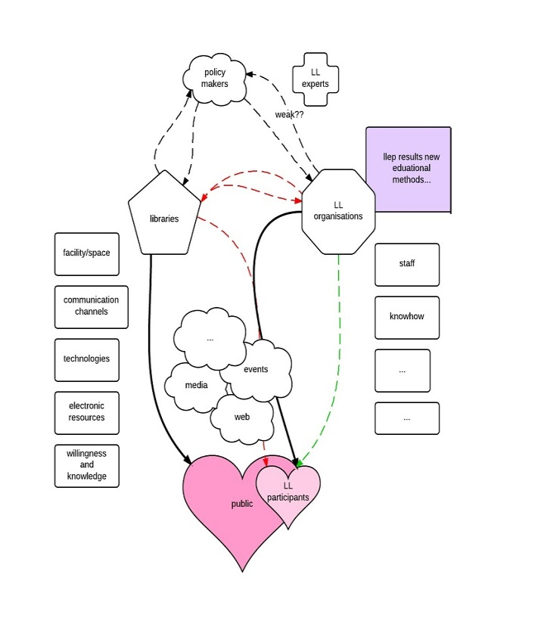
DI-XL Model defines actors and target groups for LLP results dissemination
WHO
  The main actors are libraries and LLP organizations.
  The target groups include:
Library users
Students
Library professionals
Participants of specific LLP events organized by libraries
Users of lifelong learning services
People in the labor market
Decisionmakers
Civil servants and officials
Non-governmental organizations (NGO)
Academics (teachers, lectors, trainers, researchers)
Public (general public, users of LLP results)
Media, PR
Subjects providing consultancy and informational services related to all aspects of learning/education
Research centers and subjects concerned with lifelong learning issues

Slide 8
DI-XL Model defines actors and target groups for LLP results dissemination
WHO

Slide 9
DI-XL Model Draft
  Chapter 1 LLP results
  Chapter 2 Actors and target groups
  Chapter 3 Benefits of cooperation, establishing
  partnerships
  Chapter 4 Tools and action
  Chapter 5 Knowledge and skills, training
  Glossary
WHAT
WHO
WHY
HOW

Slide 10
DI-XL Model suggests benefits for libraries and LLP organizations and a framework for establishing partnerships
WHY
BENEFITS FOR LIBRARIES | BENEFITS FOR LLP ORGANIZATIONS
Strengthening image as a center for developing and sharing knowledge, as a player in the education process | Use contacts and resources of the library community
New service for library users | Larger impact on target groups and beneficiaries
Active support of local community | Raising awareness on other LLP activities
Opportunity for library staff to gain new skills | More effective and larger sustainability of implemented projects
New fundraising opportunities | Presentation of the LLP organizations to new target groups
New partnerships for libraries | Enlarging networks, new partnerships
Establishing partnerships and agreements for mutual action
- Define roles of actors, formal/informal partnership, specifications: language, time, resources, tools, …
Concrete steps to initiate partnerships

Slide 11
DI-XL Model
  Chapter 1 LLP results
  Chapter 2 Actors and target groups
  Chapter 3 Benefits of cooperation, establishing
  partnerships
  Chapter 4 Tools and action
  Chapter 5 Knowledge and skills, training
  Glossary
WHAT
WHO
WHY
HOW

Slide 12
DI-XL Model proposes tools and action for dissemination
  Different tools relate to different forms of LLP results; may require different procedures for the actors and have different target groups.
  Proposed tools and actions may be used according to specific conditions of the actors.
  Examples
HOW
SIF, Lithuania - promotes LLP projects websites via banners on the library website (e.g., project Gender Equality
and Diversity)
Sedukon, Czech Rep., proposes dissemination of project „Safety and Health for New Workers“ – printed materials, online applications,
events

Slide 13
DI-XL Model proposes tools and action for dissemination – Chapter 4
HOW
By format | Tools | Procedures for lib staff, responsibilities | Procedures for LLP orgs, responsibilities | Target groups
Personal
 | Interviews (face-to-face, Skype, by phone…) | Inform library users about an LLP and printed/electronic information, advise and consult, recommend | Train librarians, supply them with information and materials, communicate | Library users=potential LLP trainees
 | Meetings, workshops, seminars, conferences | Invite audience, organize events, provide space, use every library event to inform about LLP | Prepare materials about an LLP to be presented at the event | Library professionals, NGO, gov’t & local authorities =partners, trainers, decisionmakers
Physical
 | Presentation of printed materials (e.g., logo, flyers, brochures, posters, books, training materials, registration forms, +other promotion materials [postcards, photo books, comics, pencils, notepads, t-shirts with logo, …]) | Display and present documents and materials in the library space, circulate materials to other relevant libraries, distribute them during social library events | Provide the library with ready-made documents and materials | Library users, public, participants of social library events =potential LLP trainees
Virtual
 | Provide electronic content (e.g., LLP web page/LLP social networks/LLP internet forum, discussion group, registered web) | Advertise and link to LLP content (text, banners, video) using various library virtual tools (web pages, library social networks (e.g., Facebook, YouTube, Foursquare, Twitter, Second Life, LinkedIn, etc.) | Build and maintain e-Toolbox, provide the library with links and inform about updates | Library users, other libraries, general public =potential LLP trainees
 | Distribute newsletters by email and listserv | Send newsletters about an LLP to relevant and cooperating libraries and institutions by email, listserv or RSS | Supply the library with ready-made newsletters | Library professionals, academics, teachers, NGO employees, civil servants and officials (e.g., labor offices, ministries), etc. =partners, trainers, academia, decisionmakers
 | News (on Facebook) | Update and publish news about an LLP on library social networks (e.g., Facebook) | Supply the library with updated information about an LLP, provide link to LLP Facebook | Library users, other libraries, public =potential LLP trainees
 | Articles | Placing articles on an LLP in electronic library periodicals | Supply the library with details for the article to be published | Library professionals =partners, trainers
 | e-learning | Provide available library e-learning platform (e.g., Moodle), administrate and maintain training materials | Develop e-learning training materials; cooperate with the library during programming | LLP trainees
Other PR tools
 | Organize press conference, press releases | Address befriended and cooperating traditional media – press, radio, TV; publish press releases on Facebook and library web | Supply the library with the official announcement for the press, present to the involved media | General public =potential LLP trainees, partners, trainers, academia, decisionmakers
 | Other creative PR tools (e.g. competitions, games, exhibitions, concerts, relevant beneficiary events) | Organize PR event with the focus on LLP presentation; provide space & resources | Create PR event to promote an LLP, collaborate with the library on logistics | General public =potential LLP trainees, partners, trainers, academia, decisionmakers

Slide 14
DI-XL Model proposes tools and action for dissemination – Chapter 4
HOW
Action date | Materials/tools | Targeted audience
00.00.0000 | Project press conference and press release – 1) media: press, radio, TV 2) library internet - web/Facebook/email/listserv/YouTube/foursquare… | 200 - 2 000 000
00.00.0000 | Links and ads from the library internet - web/Facebook/YouTube/… to project web site/Facebook/forum/blog… | 100 - 1 000
from 00.00.0000 to the end project | Display of project logo and initial printed project materials in the library | 500 - 1 000
from 00.00.0000 to the end of project | Provide personal interviews by library staff, presenting and recommending project | 500 - 1 000
00.00.0000 | Circulate initial print project materials to other relevant libraries, institutions, and authorities
00.00.0000 | Release project news on library Facebook plus friends of the project’s Facebook | 200 - 20 000
00.00.0000 | Display new and updated printed project materials(e.g., brochures, publications, training materials, etc.) in the library | 500 - 1 000
00.00.0000 | Workshop/seminar about project partners, potential cooperating libraries and institutions, policymakers | 30 - 60
from 00.00.0000 to the end of project | Update project news on library internet – web/Facebook/email/listserv… | 200 - 500
00.00.0000 | Final conference, evaluation and success analysis by project partners, cooperating libraries and institution, policymakers | 30 - 60
00.00.0000 | “project success” press conference, press release in media + library internet | 200 - 2 000 000
00.00.0000 | Display of project final report in the library and on library internet – web/Facebook, …. | 500 - 1 000

Slide 15
DI-XL Model
  Chapter 1 LLP results
  Chapter 2 Actors and target groups
  Chapter 3 Benefits of cooperation, establishing
  partnerships
  Chapter 4 Tools and action
  Chapter 5 Knowledge and skills, training
  Glossary
WHAT
WHO
WHY
HOW

Slide 16
DI-XL Model specifies knowledge and skills and training for dissemination – Chapter 5
HOW
  Libraries need to understand and be informed about LLP results.
  Librarians should use their communication and lecturing skills, including use of IT, personal motivation and enthusiasm.
  LLP organizations should provide libraries with training, specify format and timing of training sessions.
  LLP organizations should understand the possibilities of libraries.
  Both actors should regularly update and share information.
  Examples
???

